Slide 1
The Life and Leadership Style of John F. Kennedy
Ayanna Patterson
Rob rankin
Sam riser

Slide 2
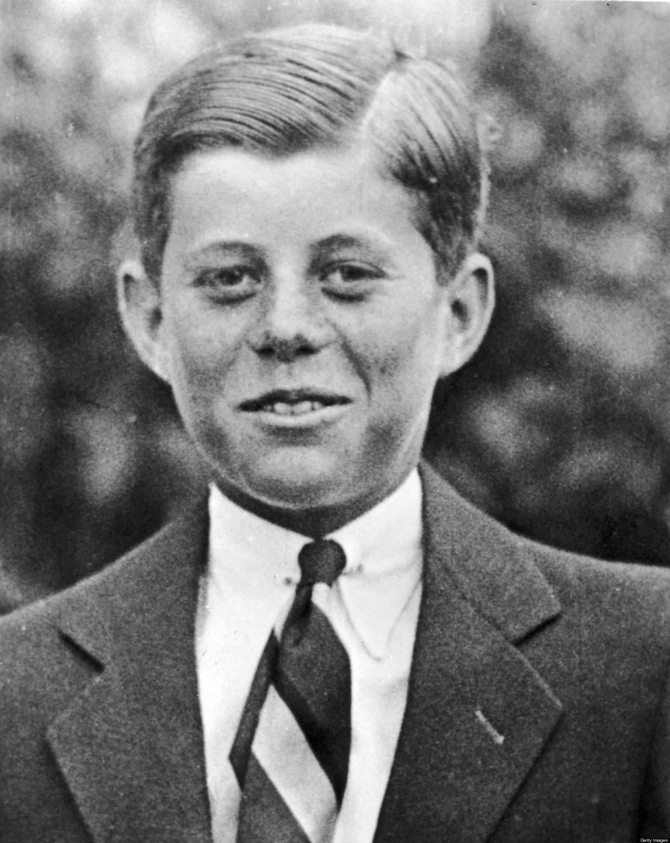
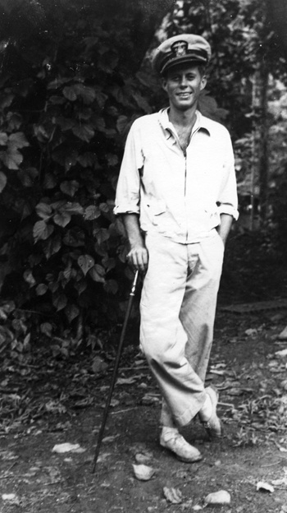
Young JFK

Slide 3
JFK with Naval Crew

Slide 4
John Fitzgerald Kennedy
Becoming A leader

Slide 5
Service
“Any man who may be asked in this century what he did to make his life worthwhile, I think can respond with a good deal of pride and satisfaction, ‘I served in the United States Navy’”
JFK, 1963
Worked for the people
Civil Rights
Cuban Missile Crisis
Qualities:
Aware
Persuasive
Conceptual

Slide 6
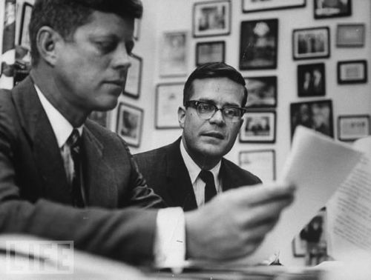
Relationship-Driven
Surrounded himself with a mosaic of talent to help carry the organization forward
Lyndon B. Johnson
Robert Kennedy
Arthur Goldberg
Ted Sorensen
Inspired those around him
to push through adversity

Slide 7
John Fitzgerald Kennedy
Leadership characteristics

Slide 8
Authoritative
Knowledgeable
Decision Maker
Experts in their field
Philosophy of hope and change
Continuous learning: “Marlborough” and “The Guns of August”
Consultants
Review all sides
Berlin Crisis - Question
Responsibility
Conviction behind statements inspired hope
Bay of Pigs
Center of Decisions
White House Organization
Wheel Structure
Quick Decision
Talent for Focus
Clear Vision and Path
The New Frontier
Notes:
KNOWLEDGEABLE:
Gathered all information to move the entire national to a particular goal
His conviction would shine through and bring people together over his philosophy of hope and change
Berlin Crisis: Nuclear War
Bay of Pigs: Horribly planned and executed Cuban Invasion
DECISION MAKING
Desire for complete power
Changed Eisenhower’s structure without hesitation
He had a talent for focus: he could see the point and get to it
Provide clear vision and a perfect path through which it can be achieved and be a success
Exercised his authority with his program the New Frontier
Peace corps, raise min wage, paid bills on housing, manpower retraining, unemployment comp, and across-the-board traffic cuts

Slide 9
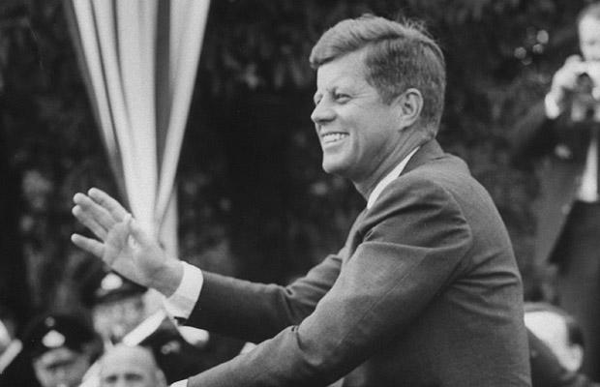
Charismatic
Great Communicator and Motivator
Communicating a clear vision of the future
Simple Ideas presented with Passion
Engage, inspire, and motivate the nation
Could go long periods with no text
Youthful and Full of Vigor
Witty, humorous, teasing, bright
Man of ideas and action
Self-Disciplined
Notes:
While he was a man of ideas and action, war, sickness, and politics gave him qualities of patience and prudence

Slide 10
Inaugural Address
“Ask not what your country can do for you; ask what you can do for your country.”
John F. Kennedy
1961

Slide 11
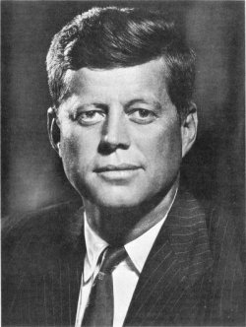
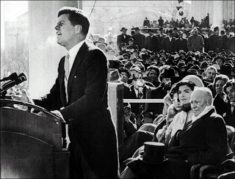
Conclusion

Slide 12
Sources
http://www.globalgolfadvisors.com/cms/wp-content/uploads/2013/09/CMAA-Servant-Leadership-Ppt-V7-aug19-PDF.pdf
http://www.thewashingtonnote.com/twn_up_fls/sorensen%20kennedy.jpg
http://www.washingtonpost.com/blogs/on-leadership/wp/2013/11/20/lead-like-john-f-kennedy/
http://www.presidential-leadership.com/johnfitz-174.htm

